Slide 1
Information flows
SESSION 19

Slide 2
Communication flow in the Organization
Downward Communication
Upward Communication
Lateral Communication
Horizontal communication
Diagonal Communication

Slide 3
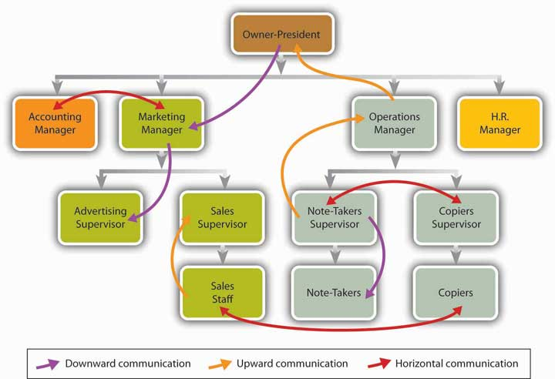

Slide 4
Downward Communication
Decisions made at the top and passed on to workers at the lower levels of Hierarchy.
e.g.
M.D directing his secretary to convene a Board meeting
She asking managers to furnish details for the meeting
People further down may asked to make physical arrangements e.g. seating and refreshment.
Downward communication is done by formal letters ,circulars, orders etc.

Slide 5
Downward Communication
Advantages:
Centralized control
Promptness and efficiency of correspondence
Clear job descriptions
Easy decision making process
Formal sharing of work
Disadvantages
Danger of over centralization
Too many levels may cause delay
Lack of transparency may causes dissatisfaction and conflict
No room for feedback and consultation

Slide 6
Upward Communication
Communication travels from the people at the bottom and reaches the upper levels of the organization structure.
This upstream communication is essential for day to day administration of an organization.
Periodical reports ,plans, proposals and appraisals are forms of upstream communication.

Slide 7
Upward Communication
Advantages:
Participatory decentralization of work
Team work
Speedier redress of grievances
Disadvantages
Interpersonal problems created by the ego of those in higher levels in hierarchy
Rivalry between employees .

Slide 8
Lateral Communication
Communication between any two or more officers at the same level is Lateral Communication.
Used for mutual consultation and sharing of information.
Managers of different departments/Functional managers use such means to confer with each other.

Slide 9
Lateral Communication
Advantages:
It helps in solving difficult problems
Coordination of work among different departments
Easier crisis management
Internal feedback for corporate functioning
Disadvantages:
The consultation not resulting in decisions
Interpersonal problems among equals

Slide 10
Diagonal Communication
It takes place among employees and managers who are at higher or lower levels.
e.g.
A Marketing Manager may consult the Advertising Production Chief down the line through the Director of Advertising;
Or the manager of Finance may interact with the Sales Manager or the Retail Sales Director two levels down the hierarchy.

Slide 11
Diagonal Communication
Advantages:
Flexibility of communication across different levels
Speedier transaction of business
Easier organization of formal and informal meetings involving different levels
Disadvantages:
Crosswise communication builds up crosswise informal relations
Subordinates will refrain from making commitments beyond their authority
Slackening control

Slide 12
Channels of Communication
Formal Communication refers to a style or form of writing, speaking or behavior communicated through the upper levels of hierarchy.
E.g. He/she cannot meet the boss without a prior appointment.
Advantages:
Ensures information flow.
A favorable image of the organization is built up through formal correspondence.
Promotes team work and coordination
Ensures centralized control down the hierarchy

Slide 13
Formal Communication
Disadvantages
Limit individual freedom and inhibit lower level workers from freely interacting with higher level functionaries.
Time consuming and expensive.
Encourages filtering of information

Slide 14
2. Informal Communication refers to a relaxed and friendly attitude which does not require strict rules of how to behave or speak or write or communicate the information in the hierarchy.

Slide 15
Grapevine: The Informal Network of Communication
Informal communication is often called grapevine, when it happens behind one’s back.
“It is a complex network of communication in an organization which conveys rumors and comments under the pretence of secrecy.

Slide 16
Grapevine Phenomenon
Advantages:
Managers can study the hidden mind of the workforce. The feedback value is thus immense.
It is the speediest channel of communication.
Disadvantages:
Information may not be reliable
Often distorts facts and misinforms.
it may send false alarms and raise unnecessary fears to cause mistrust among colleagues.

Slide 17
Effective Management of the Grapevine
Transparency in decision making process
Frequent dialogues with employees at all levels providing sense of involvement and belonging
Teamwork and widely shared responsibilities
Effective listening at managerial levels
Identifying areas of discontent among employees
Good public relations, both internal and external

